Slide 1
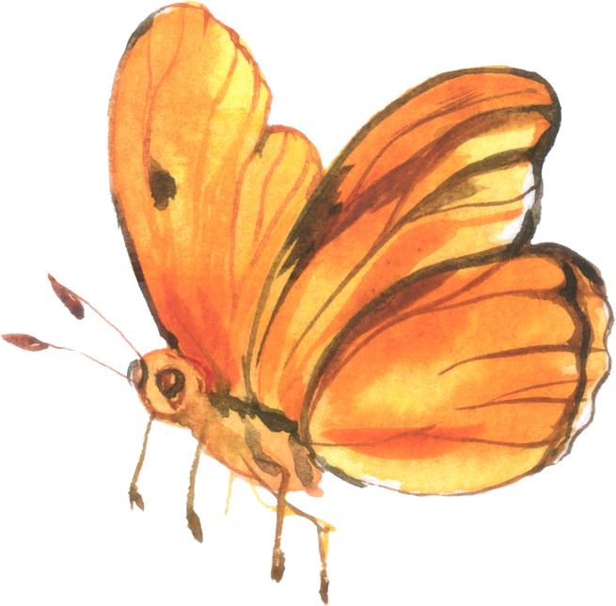
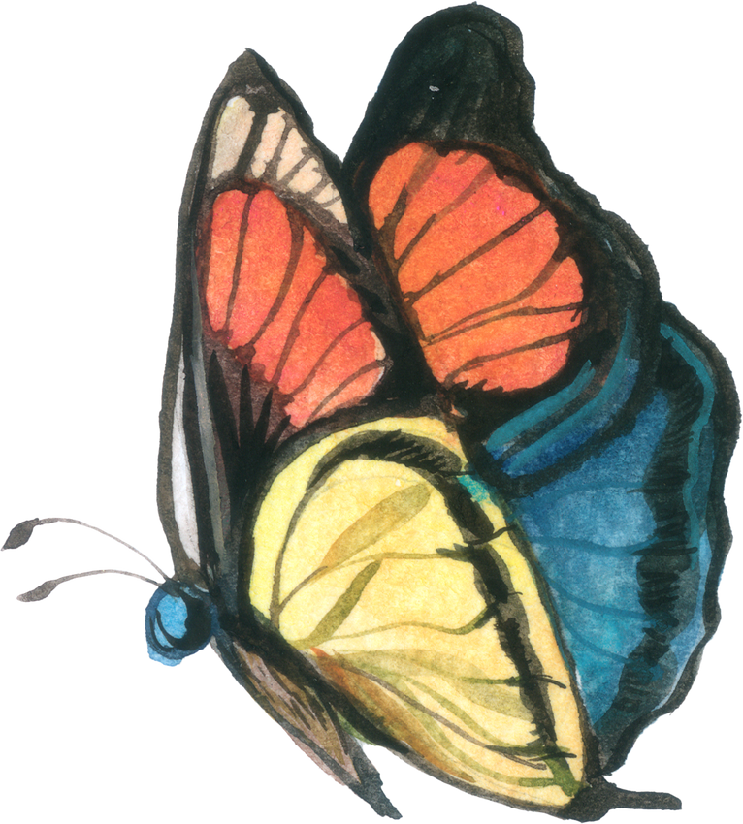
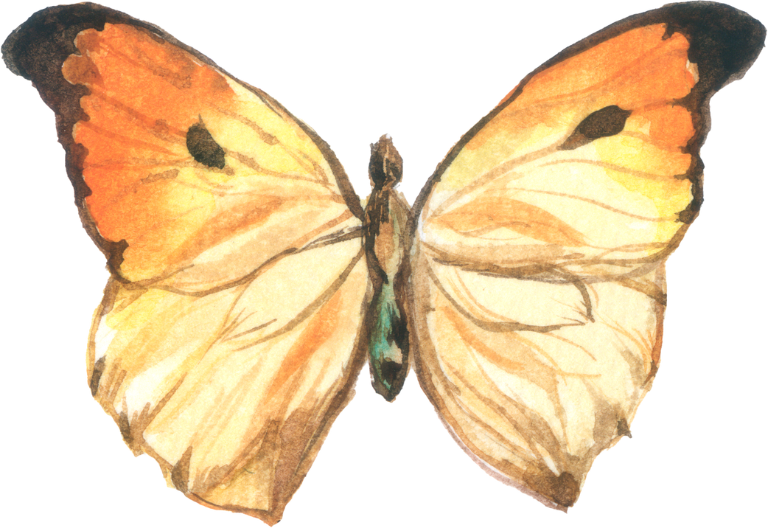
LATENT DIFFUSION BASED IMAGE GENERATION
WEB APP
This presentation outlines the process of building a full-stack text-to-image Generative AI web application. The app will be powered by Stable Diffusion, a powerful deep learning model.
SATHWIK REDDY CHELEMELA
YAYAN LI
VISHAD MEHTA

Slide 2
OBJECTIVE
The project involves fine-tuning only the diffusion model on a custom image-caption dataset while keeping the pre-trained text and image encoders frozen, ensuring parameter-efficient adaptation. The final application will include both a user-friendly front-end interface and a scalable back-end pipeline for inference.
Dataset Details:
Key Features:
Name: ceyda/smithsonian_butterflies
Size: 9213 images
Format: Image-caption pairs
RGB Images
Metadata Fields (name, region, stage)

Slide 3
APPROACH 1:
IMPLEMENTATION USING CONV VAE AND ENCODER
Custom Convolutional VAE
Built with Residual Blocks & U-Net (unfreezed)
CLIP Tokenizer
Utilizing a small text encoder (unfreezed)
Training
9213 images used to train VAE (25 epochs), Diffusion U-Net (30 epochs)
Gradio Demo
Interface launched at script end

Slide 4
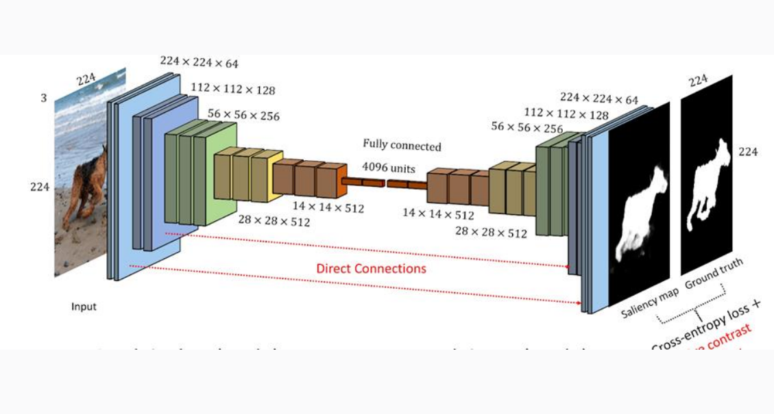
ARCHITECTURE OF APPROACH 1 :

Slide 5
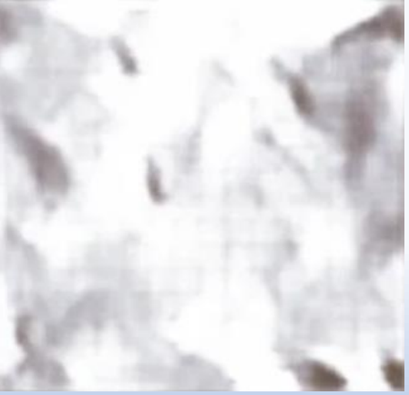
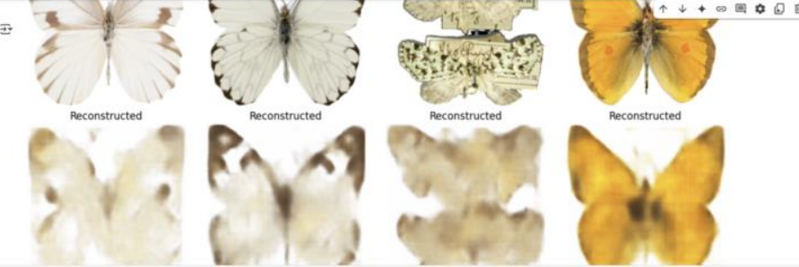
RESULTS
Qualitative
Quantitative
Performance
• Butterfly shapes not recognized
• Blurred details
• Noisy backgrounds
• VAE loss: ~0.015 (plateaued)
• Diffusion MSE loss: ~0.04 → ~0.018
• Training: 4 hrs (VAE) + 6 hrs (diffusion)
• Inference: ~2 sec/image
Output from VAE
Diffusion model output

Slide 6








APPROACH 2:
STABLE DIFFUSION V1-4 PIPELINE USING
CUSTOM UNET WITH ATTENTION
Load Components
AutoencoderKL, DDPMScheduler, CLIPTextMode
Freeze Weights
VAE & text encoder weights frozen
Custom Dataset
Batch size = 4 loaded 9213 images
Training
10 epochs, checkpoint saved at each epoch

Slide 7
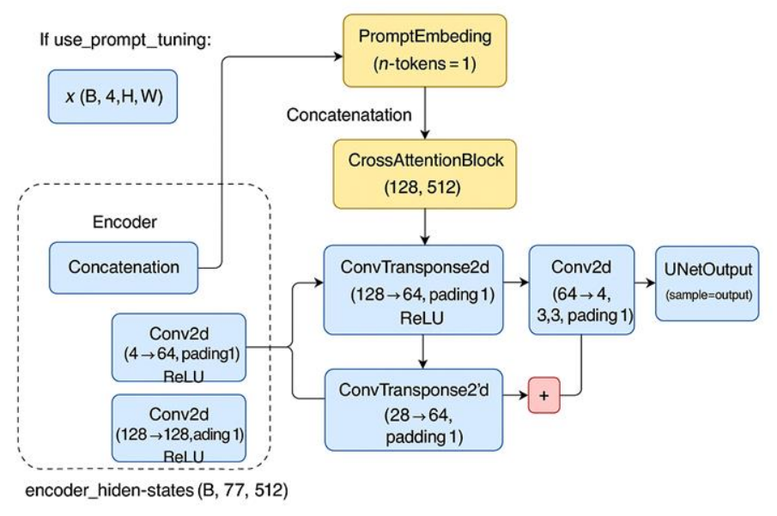
APPROACH 2 : CUSTOM UNET WITH ATTENTION
It's a U-Net-style autoencoder used primarily for denoising tasks (like in diffusion models).
Integrates Cross-Attention to inject conditional information from text embeddings (like from CLIP or a text encoder).
Freezed VAE and text encoders

Slide 8
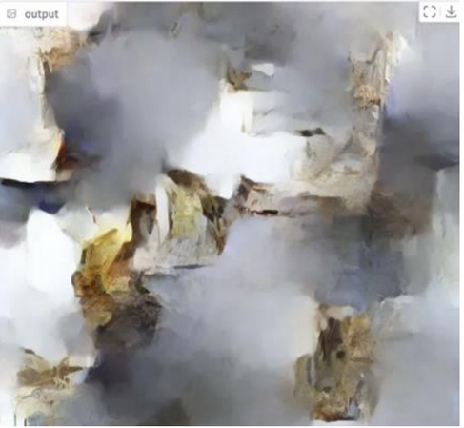



RESULTS
Qualitative
Quantitative
Performance
Reduced training time of approximately 2 hours on one GPU. Faster inference at approximately 1.2 seconds per image.
Image is still very noisy and blurry, can’t make out butterflies at all but some colors appear.
Unet MSE loss decreased from ~0.035 to ~0.010 by epoch 10.
Some colors appear
Starting to take shape but still mostly noise.
Better training time
Diffusion model output

Slide 9
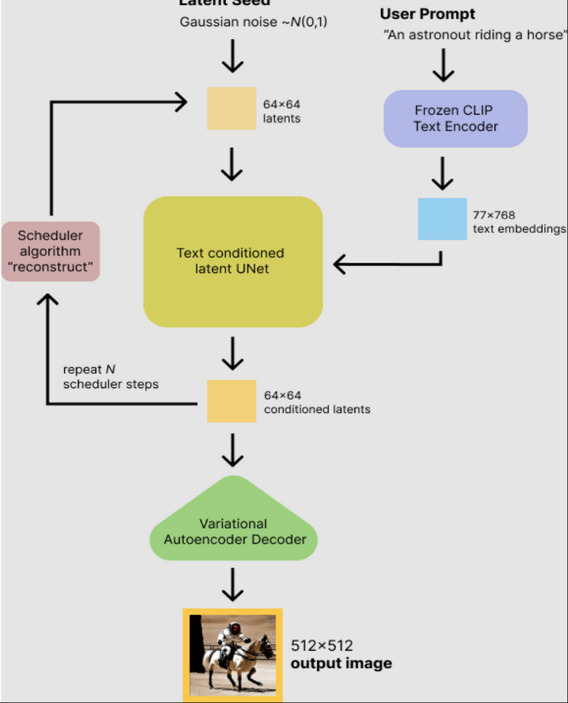
APPROACH 3:
STABLE DIFFUSION V1-5 PIPELINE
Pipeline Source
runwayml/stable-diffusion-v1-5
Key Differences
• Stable Diffusion Pipeline
• VAE & Text Encoder frozen
Training Details
• 10 epoch (proof-of-concept)
• Gradient accumulation, max gradient norm
• 1000 images loaded to save computational power

Slide 10
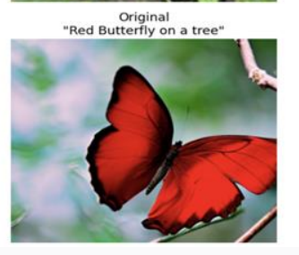
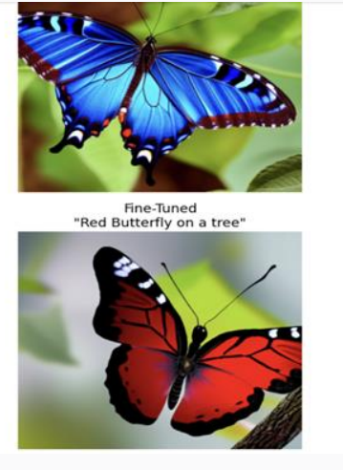
RESULTS
Qualitative
Quantitative
Performance
50 min training for 10 epochs on 1 A-100 GPU, Inference ~1 sec/image.
Clear wing edges, background coherence .
Single-epoch MSE loss ~0.012

Slide 11
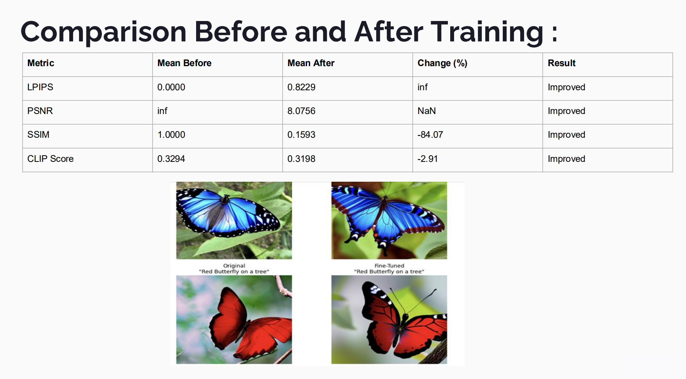

Slide 12
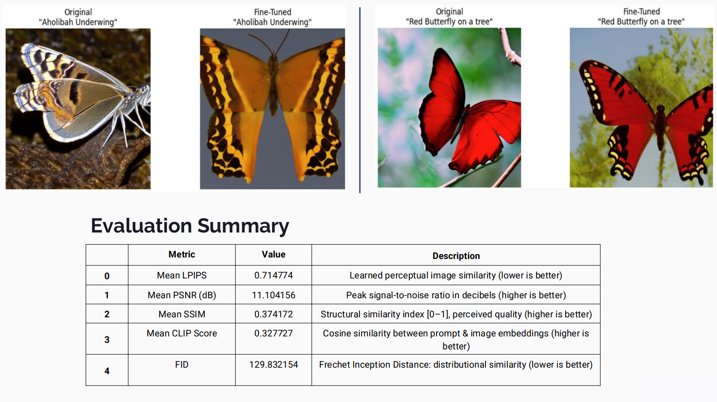

Slide 13
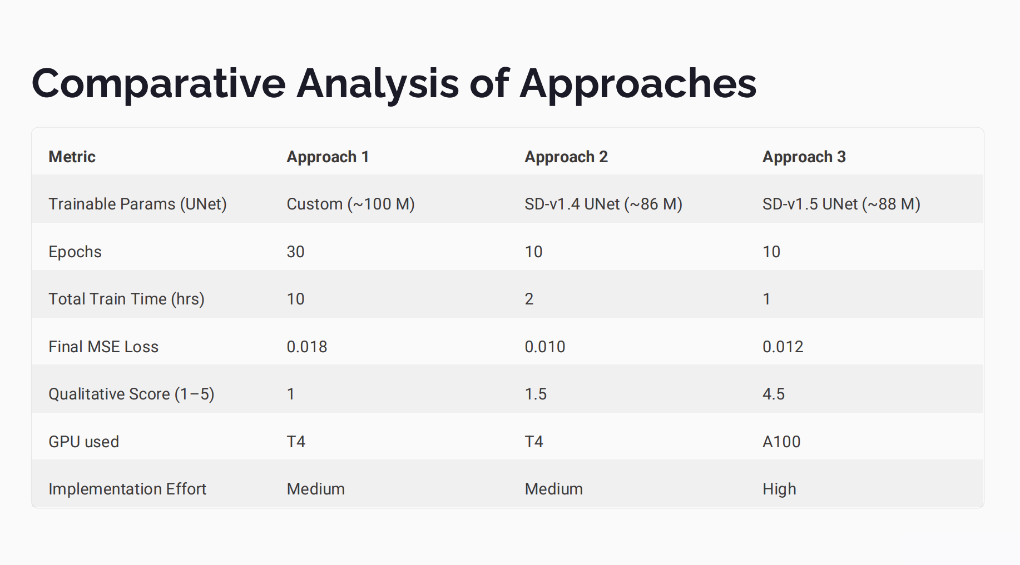

Slide 14
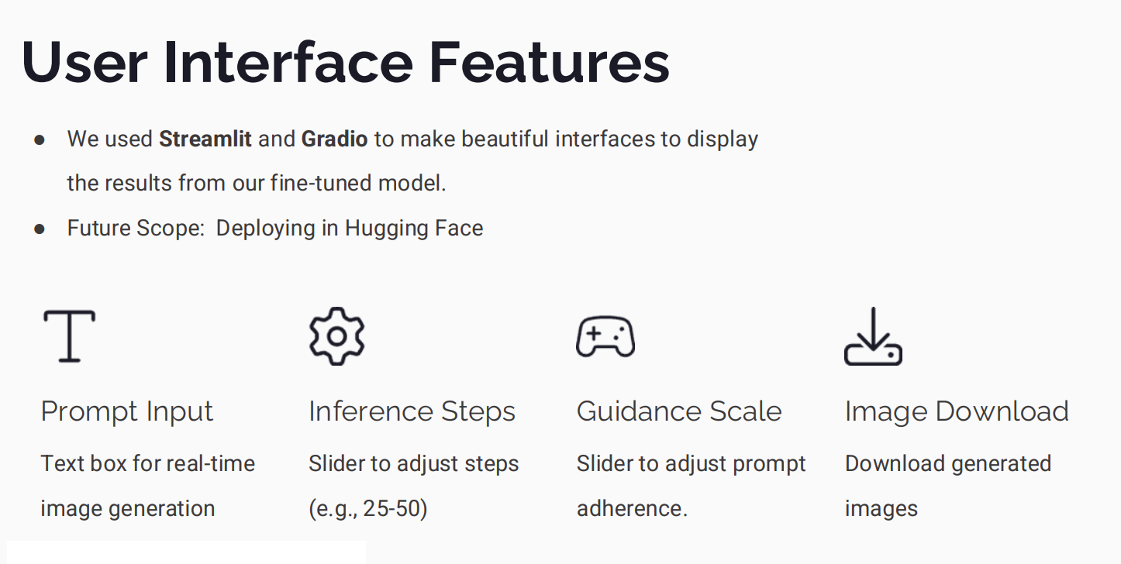




Slide 15
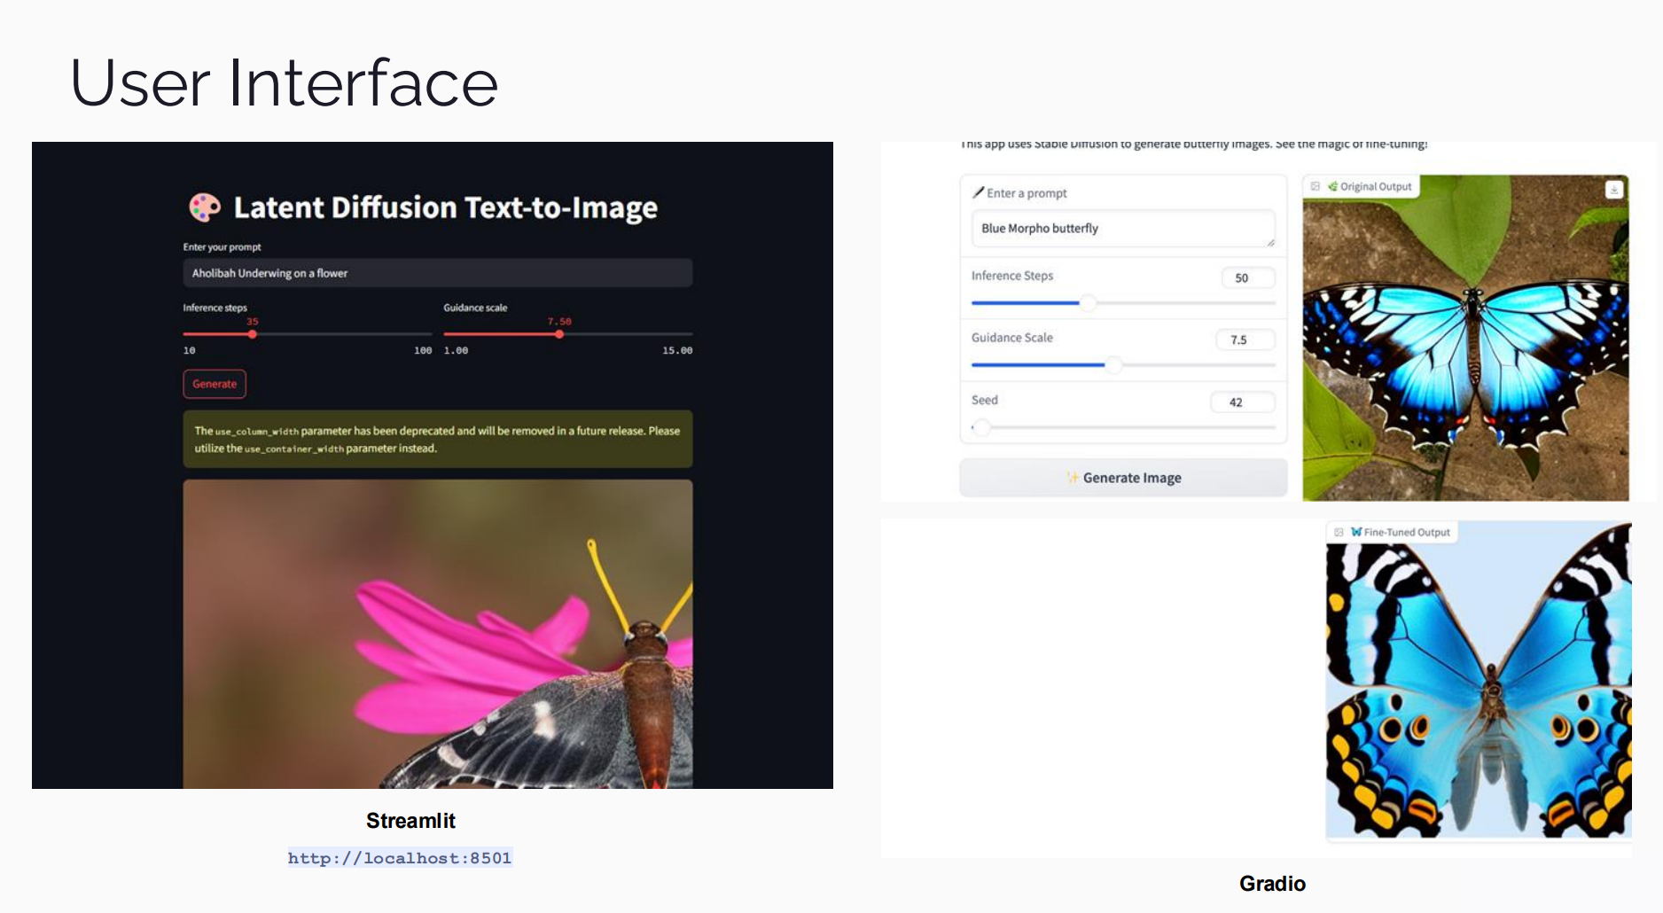

Slide 16
CONCLUSION
This project successfully implemented a full-stack text-to-image generation system using the Stable Diffusion v1-5 pipeline, focusing on fine-tuning only the U-Net component while keeping the VAE and CLIP text encoder frozen. By adopting this parameter-efficient approach, the application achieved a strong balance between training speed and output quality.
Using Approach 3 (Stable Diffusion v1-5), we built an efficient full-stack text-to-image app by fine-tuning only the U-Net while keeping the VAE and text encoder frozen.

Slide 17
Thank you
Great beginnings often lead to excellent outcomes.

